Slide 1


Slide 2

Day 3: Agenda
Introduction to Logistic Regression
Binary Classification Problem
Logit Function and Odds Ratio
Binary vs. Multiclass Logistic Regression
Classification Metrics
Confusion Matrix Interpretation
ROC Curves and AUC
Practical Examples
Model Interpretation

Slide 3
Logistic Regression
Logistic Regression models the relationship between a binary dependent variable (often denoted as "Y") and one or more independent variables (often denoted as "X").
It uses the logistic function, also known as the sigmoid function, to transform a linear combination of the independent variables into a value between 0 and 1. This transformed value represents the probability of the dependent variable belonging to one of the two classes (e.g., 0 or 1, "Yes" or "No").
Key Characteristics:
Output: Probabilities between 0 and 1.
Nature: It's a classification algorithm.
Decision Boundary: A threshold is set (usually 0.5) to classify the observations into one of the two classes based on the predicted probabilities.
Notes:
Note: Use – Jupyter File for this example - Multiple LR - Housing Dataset.ipynb

Slide 4
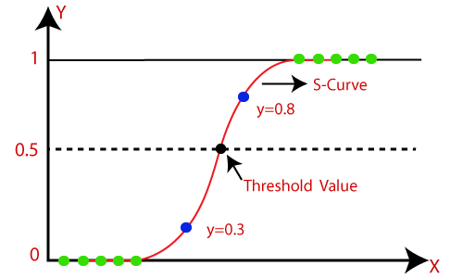
Logistic Regression

Slide 5
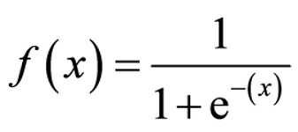
Sigmoid Function
The sigmoid function, also known as the logistic function, is an S-shaped curve that maps real numbers to values between 0 and 1. Its formula is:
Mapping to Probabilities:
In machine learning, the input f(x) often represents a linear combination of features and parameters.
The sigmoid function calculates f(x), which is interpreted as a probability estimate.
If f(x) > 0.5, it predicts one class; if f(x) ≤ 0.5, it predicts the other.
The sigmoid function is widely used in logistic regression and neural networks for modeling and predicting binary outcomes due to its ability to map real values to probabilities.

Slide 6
Logit Function
The logit function, often denoted as logit(p), is used to transform probabilities into a range of real numbers. It is the natural logarithm of the odds of an event occurring. Mathematically, it is defined as:
logit(p)=ln(p/(1−p))
Where:
logit(p) is the logit function.
p is the probability of an event occurring
It takes probabilities between 0 and 1 and maps them to a range of real numbers from negative infinity to positive infinity.

Slide 7
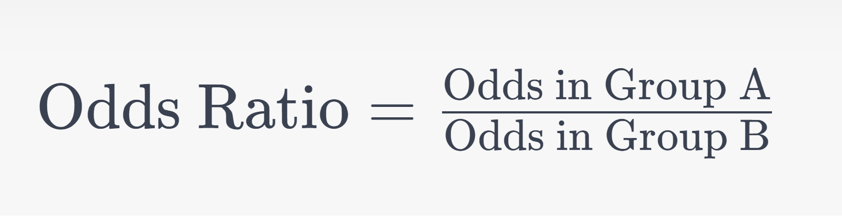
Odds Ratio
The odds ratio is a measure of how the odds of an event compare between two different groups. It quantifies the likelihood of an event happening in one group relative to another. The formula for calculating the odds ratio is:

Slide 8
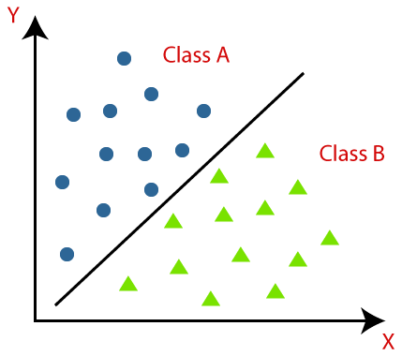
Binary Classification
It's a machine learning task where data is divided into two categories: positive (1) or negative (0).
Examples:
Spam email detection (spam or not spam), medical diagnosis (disease present or absent).
Positive Class (1): Represents the event of interest, like disease presence or spam.
Negative Class (0): Represents the absence of the event.
Choice of Positive Class: Depends on the problem context and what you want to predict.

Slide 9
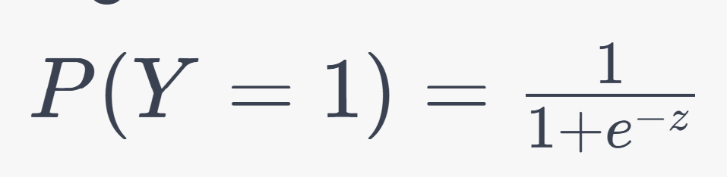
Binary Logistic Regression
Application: Used for binary classification (e.g., yes/no, 1/0).
Equation: It estimates the probability of the positive class (1) using the logistic function:
Decision Boundary: Typically set at 0.5; P(Y=1) > 0.5, it predicts the positive class; otherwise, the negative class.
Training: Adjusts coefficients (β) to fit the data, maximizing the likelihood.
Binary logistic regression is simple, interpretable, and used in fields like spam detection and medical diagnosis.

Slide 10
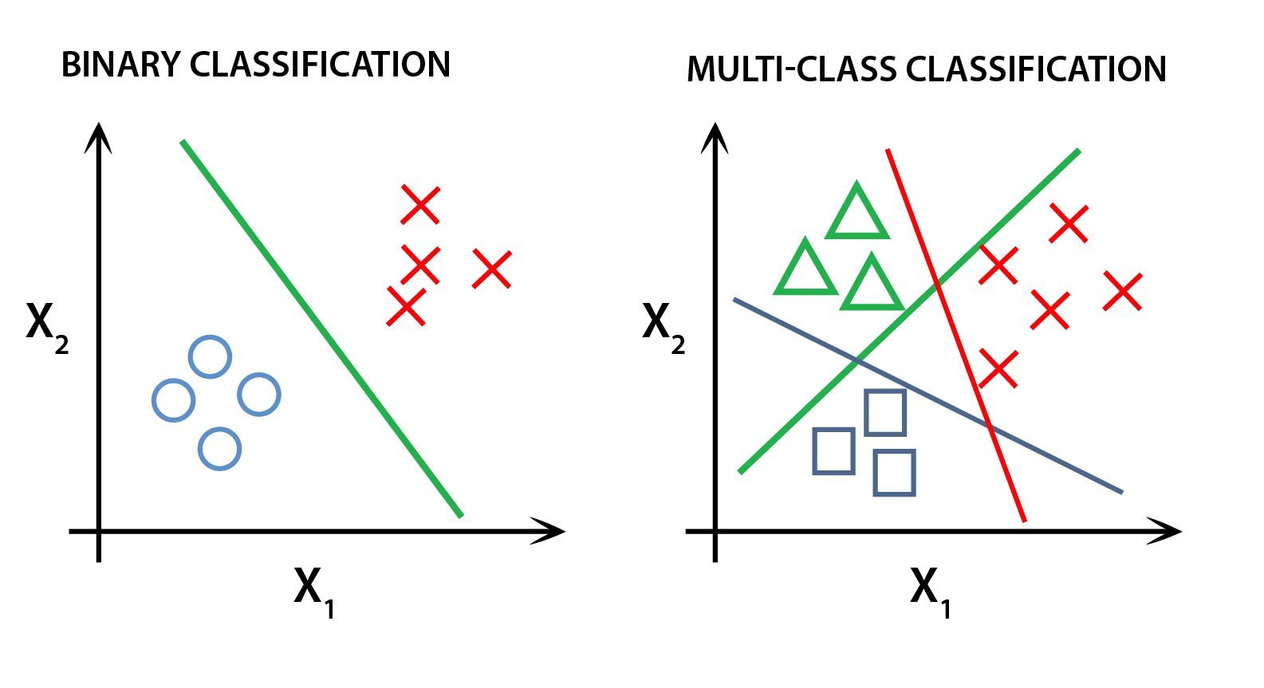
Multiclass Classification
It's a machine learning task where data is categorized into three or more classes, not just two.
Examples:
Recognizing handwritten digits (0-9), categorizing images into various objects or species, classifying text documents into topics, and more.
Use Cases: Applied in diverse fields like image recognition, natural language processing, medical diagnosis, and product categorization.
In multiclass classification, the model learns to assign data points to multiple possible classes based on the input features.

Slide 11
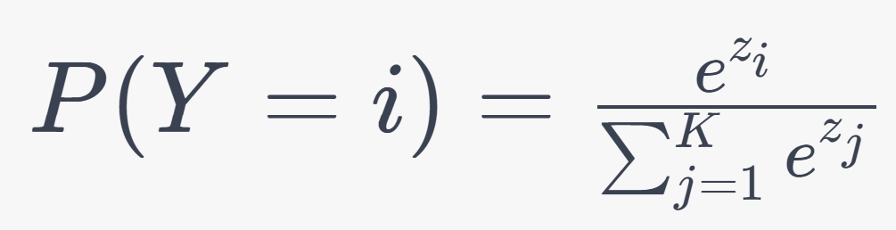
Multiclass Logistic Regression
It extends binary logistic regression for problems with more than two classes.
Softmax Function: Uses the softmax function to convert raw scores into class probabilities, ensuring they sum to 1.
Training: Learns model parameters to maximize likelihood across all classes.
Prediction: Assigns the class with the highest probability as the prediction.
Multiclass logistic regression is used for multiclass classification tasks like image categorization or document topic classification.

Slide 12
Classification Metrics
Classification metrics assess the performance of classification models.
The Need for Evaluation Beyond Accuracy:
Class Imbalance: Accuracy can be misleading when one class dominates.
Cost-Sensitive Apps: Some errors are costlier than others.
Trade-offs: Models may prioritize precision or recall based on the problem.
Threshold Adjustment: The threshold for classification can vary.
Common metrics include precision, recall, F1-score, specificity, AUC-ROC, and AUC-PRC, offering a more comprehensive view of model performance than accuracy alone. The choice of metrics depends on the specific needs of your application.

Slide 13
Classification Metrics
Common classification metrics beyond accuracy include:
Precision: The proportion of true positive predictions among all positive predictions. It measures the model's ability to avoid false positives.
Recall (Sensitivity or True Positive Rate): The proportion of true positive predictions among all actual positive instances. It assesses the model's ability to capture all positive instances.
F1-Score: The harmonic mean of precision and recall. It balances precision and recall and is useful when there is an uneven class distribution.
Specificity (True Negative Rate): The proportion of true negative predictions among all actual negative instances. It measures the model's ability to avoid false negatives.
Area Under the ROC Curve (AUC-ROC): A measure of a model's ability to distinguish between classes, particularly in imbalanced datasets. It considers different threshold levels.
Area Under the Precision-Recall Curve (AUC-PRC): Similar to AUC-ROC but focuses on the precision-recall trade-off, making it useful when there is a class imbalance.

Slide 14
Confusion Metrics
A Confusion Matrix is a fundamental tool in classification tasks that provides a comprehensive summary of a classification model's performance by showing the count of correct and incorrect predictions made by the model. It is especially valuable when assessing the performance of binary and multiclass classification models.
A confusion matrix is organized as a grid with four important components:
True Positives (TP): The number of instances correctly predicted as the positive class.
True Negatives (TN): The number of instances correctly predicted as the negative class.
False Positives (FP): The number of instances incorrectly predicted as the positive class (Type I error).
False Negatives (FN): The number of instances incorrectly predicted as the negative class (Type II error).

Slide 15
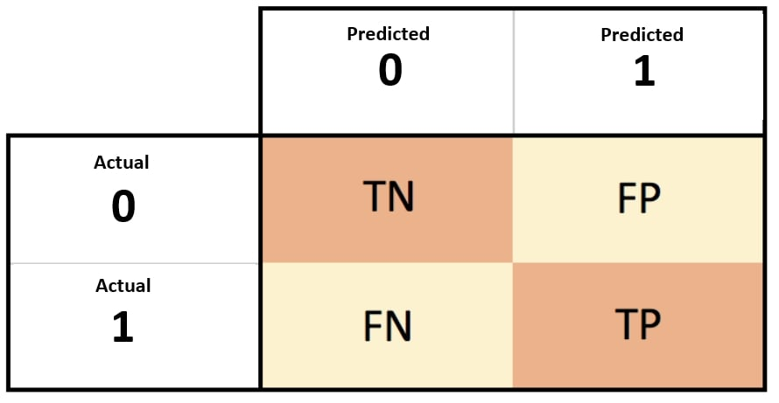
Confusion Metrics

Slide 16
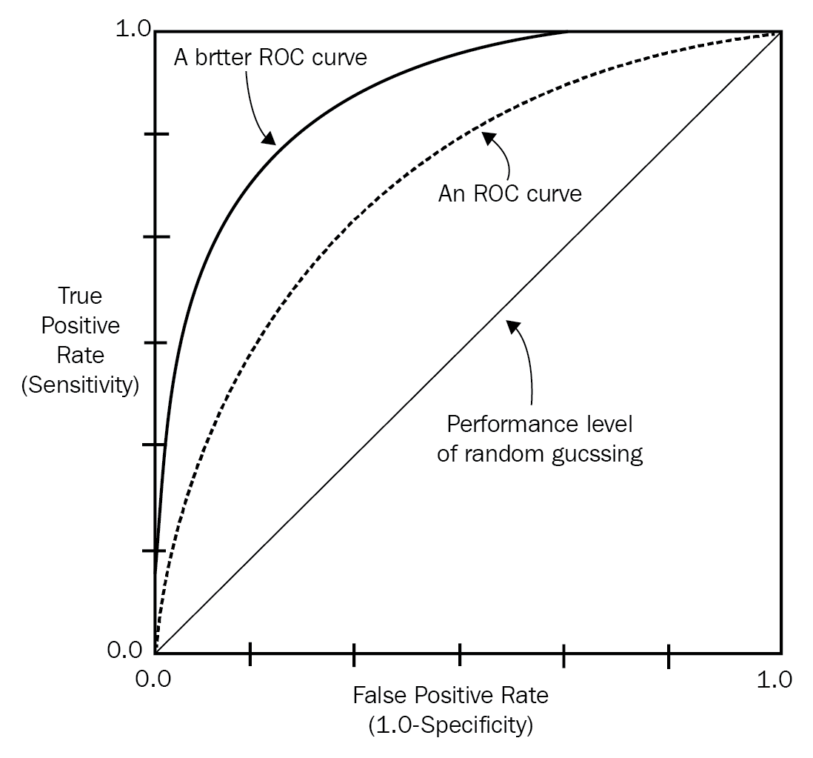
ROC Curves (Receiver Operating Characteristic Curves)
Graphical plots that assess a binary classification model's performance by showing the trade-off between true positive rate (sensitivity) and false positive rate (1-specificity) across different thresholds.
Interpretation:
Better models have curves above the diagonal line (random guessing).
AUC-ROC quantifies overall performance (0.5 = random, 1.0 = perfect).
Threshold adjustments balance sensitivity and specificity.
Used to compare classifiers.

Slide 17
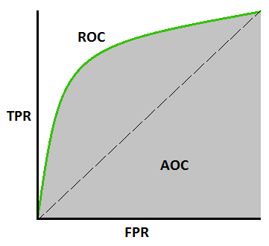
AUC (Area Under the Curve)
AUC (Area Under the Curve) is a metric for binary classification models.
It measures a model's ability to distinguish between positive and negative instances.
Higher AUC indicates a better model.
Calculate AUC by creating an ROC curve and measuring the area under it.
Useful for comparing models and handling imbalanced datasets.

Slide 18
Hands-on: Binary Classification
Practical Example 1 (Binary Classification)
Walkthrough of a binary classification problem.
Model training and evaluation using logistic regression and metrics.
Dataset - Breast Cancer Dataset
Notes:
Note – Use Jupyter file for this example - Binary Classification - Breast Cancer Dataset.ipynb

Slide 19
Hands-on: Multiclass Classification
Practical Example 2 (Multiclass Classification)
Walkthrough of a multiclass classification problem.
Model training and evaluation for multiclass logistic regression.
Dataset – Iris Dataset
Notes:
Note – Use Jupyter file for this example - Multiclass Classification - LR (Iris Dataset).ipynb

Slide 20
Questions ?

Slide 21
Thank You !

